Slide 1
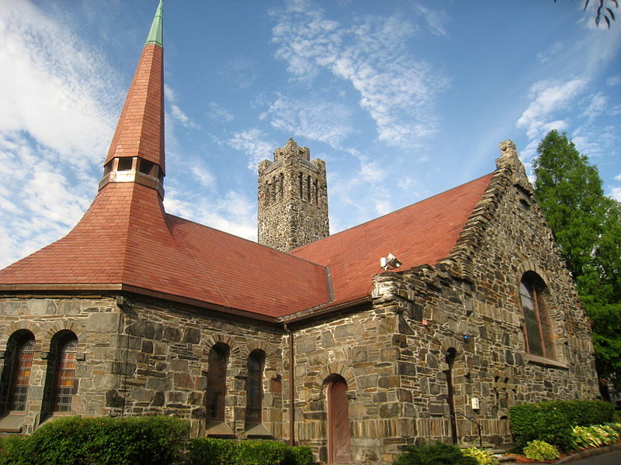
Tufts University; Goddard Chapel
commons.Wikimedia.com

Slide 2
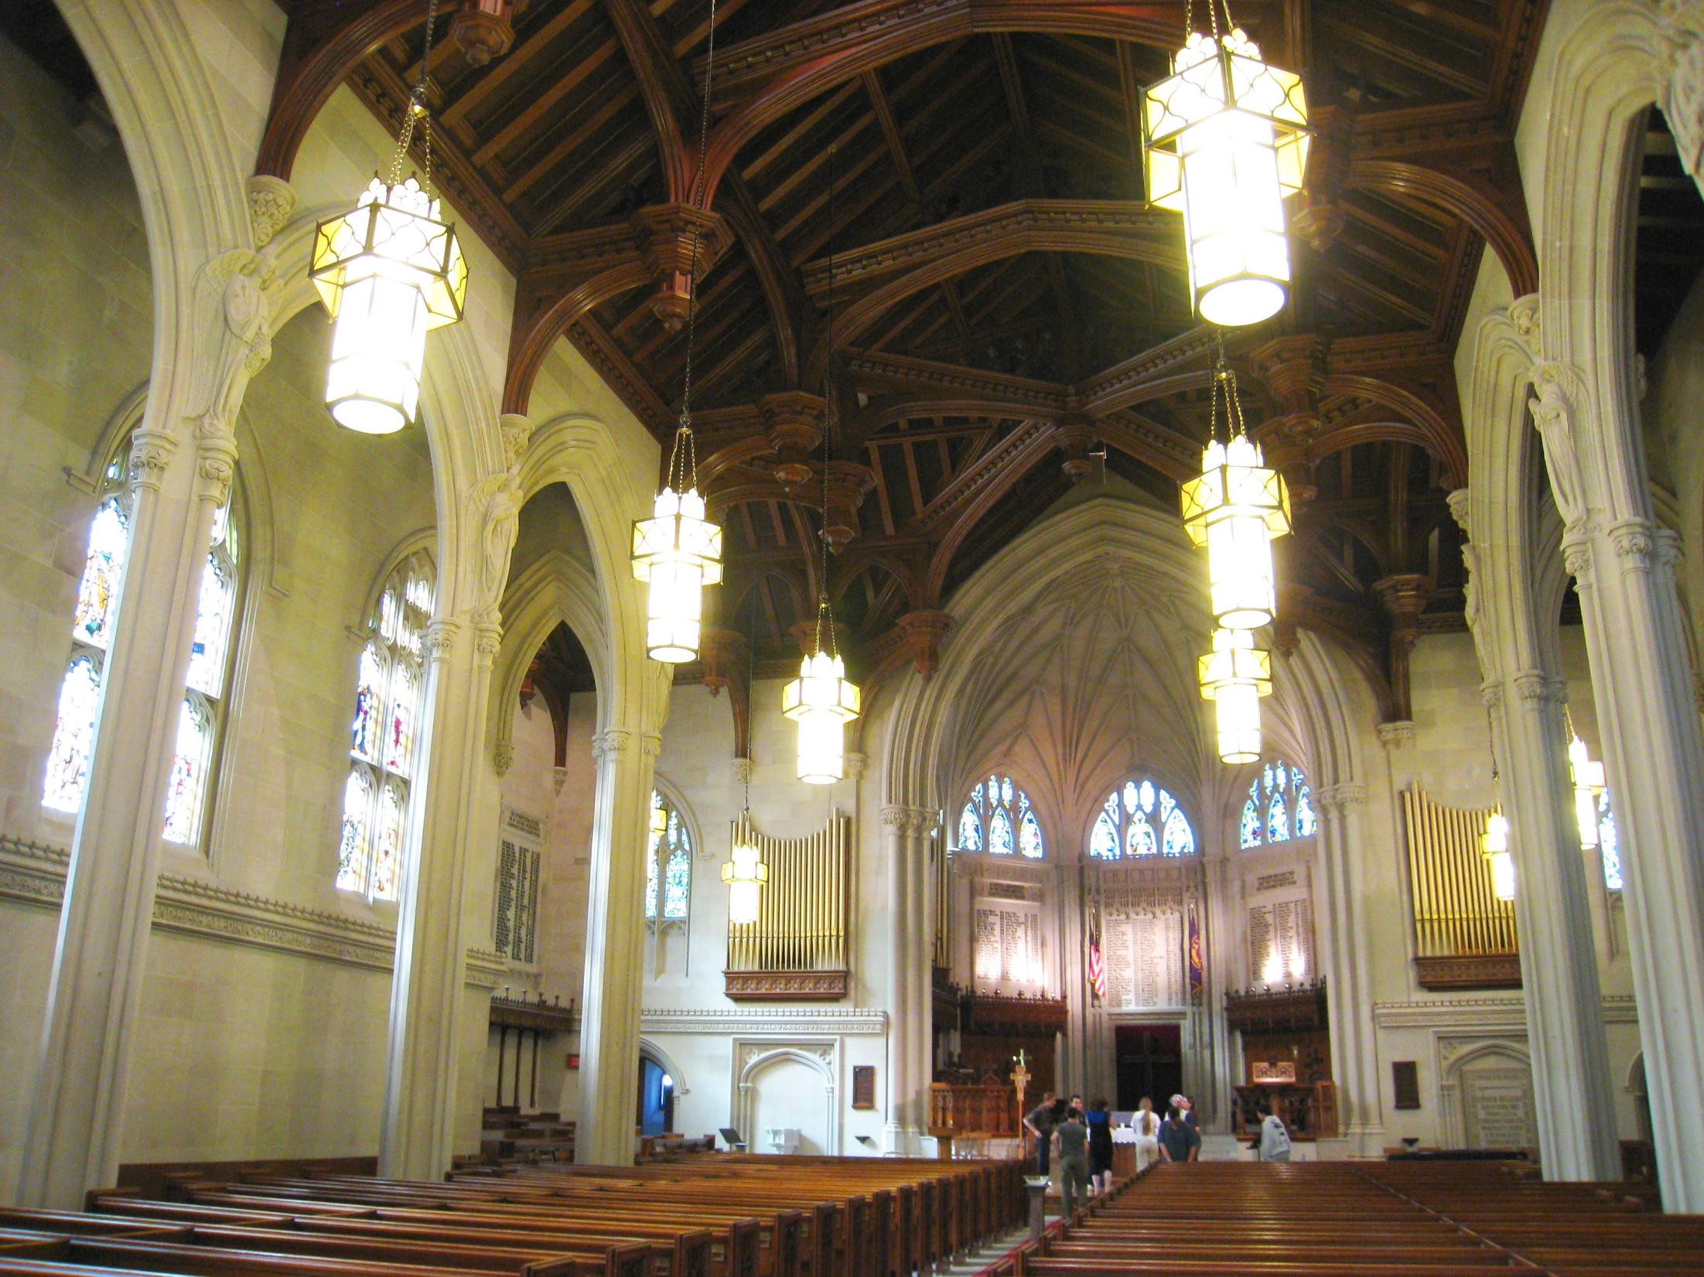
Williams College
Thompson Memorial Chapel
commons.Wikimedia.com

Slide 3
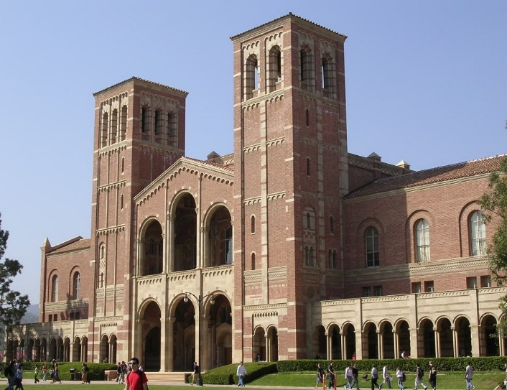
Royce Hall / UCLA.edu
Royce Hall / UCLA.edu

Slide 4
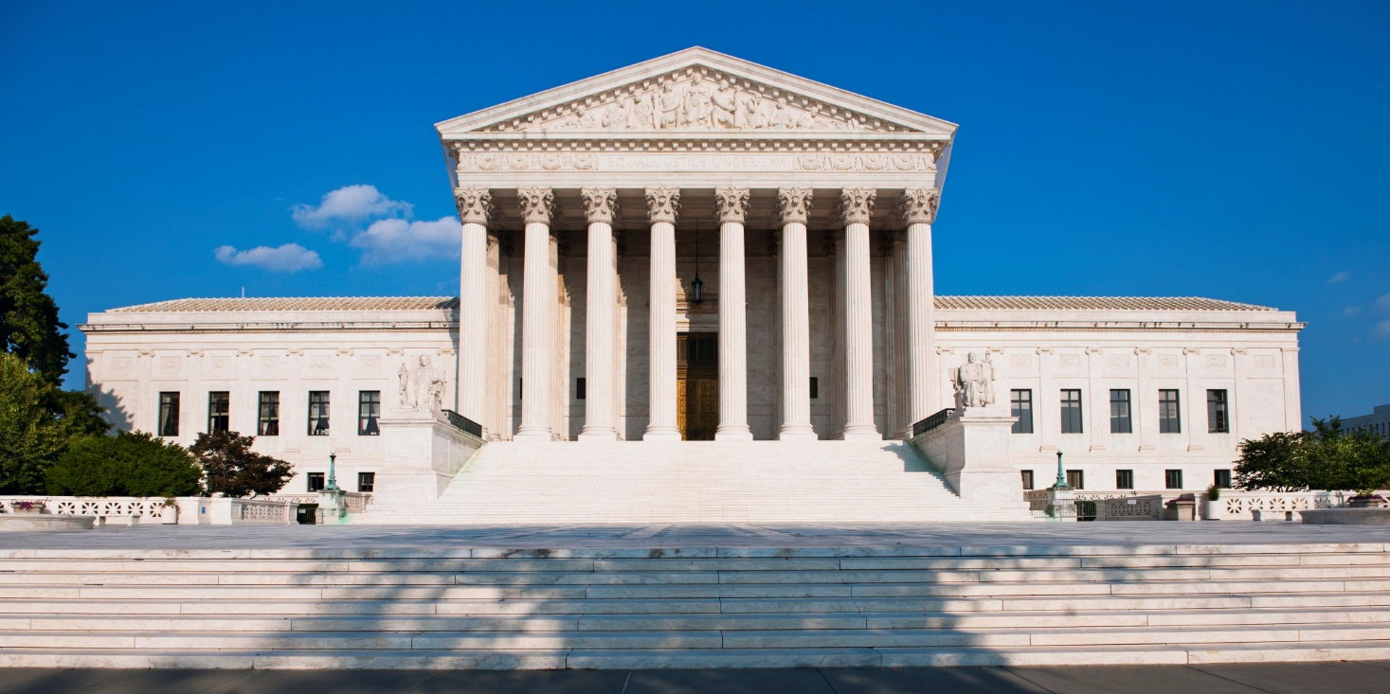
US Supreme Court / HuffingtonPost.com

Slide 5
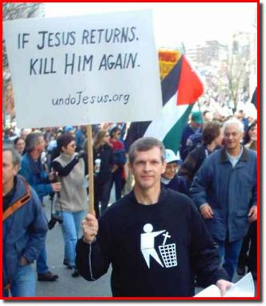
1 John 3.12-13 NET: And why did he murder him? Because his deeds were evil, but his brother's were righteous. Therefore do not be surprised, brothers and sisters, if the world hates you.
image from pastorshearer.net

Slide 6
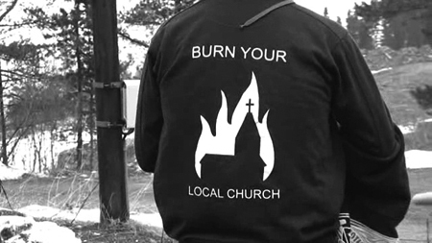
2 Timothy 3.12 NIV: In fact, everyone who wants to live a godly life in Christ Jesus will be persecuted.
image from eilc.tumblr.com

Slide 7
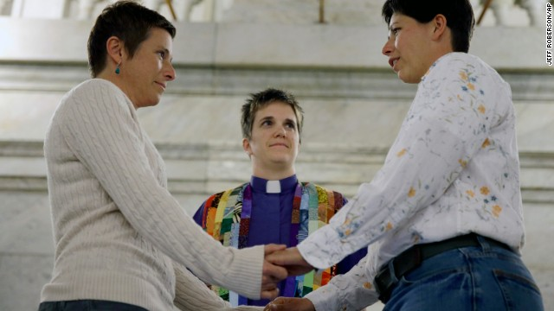
Homosexual marriage officiated by a Presbyterian Church USA minister
image from cnn.com

Slide 8
Results of persecution on InterVarsity
2001 2015
Campuses 533 649
Students/Faculty 32,000 40,000

Slide 9
Results of persecution on InterVarsity
2001 2015
Campuses 533 649
Students/Faculty 32,000 40,000
Why?
Because theology matters to these people!

Slide 10
Results of persecution on InterVarsity
2001 2015
Campuses 533 649
Students/Faculty 32,000 40,000
Why?
Because theology matters to these people!
Because they had a biblical and historical perspective.

Slide 11
Acts 8.1 NET: Now on that day a great persecution began against the church in Jerusalem, and all except the apostles were forced to scatter throughout the regions of Judea and Samaria.
Acts 11.19 NET: Now those who had been scattered because of the persecution that took place over Stephen went as far as Phoenicia, Cyprus, and Antioch...

Slide 12
John 15.18-19 NET: [Jesus speaking]
“If the world hates you, be aware that it hated me first. If you belonged to the world, the world would love you as its own. However, because you do not belong to the world, but I chose you out of the world, for this reason the world hates you.”
Results of persecution on InterVarsity
4000 first time professions of faith in 2014-2015
Up 21% from previous year
Up 172% from ten years ago

Slide 13
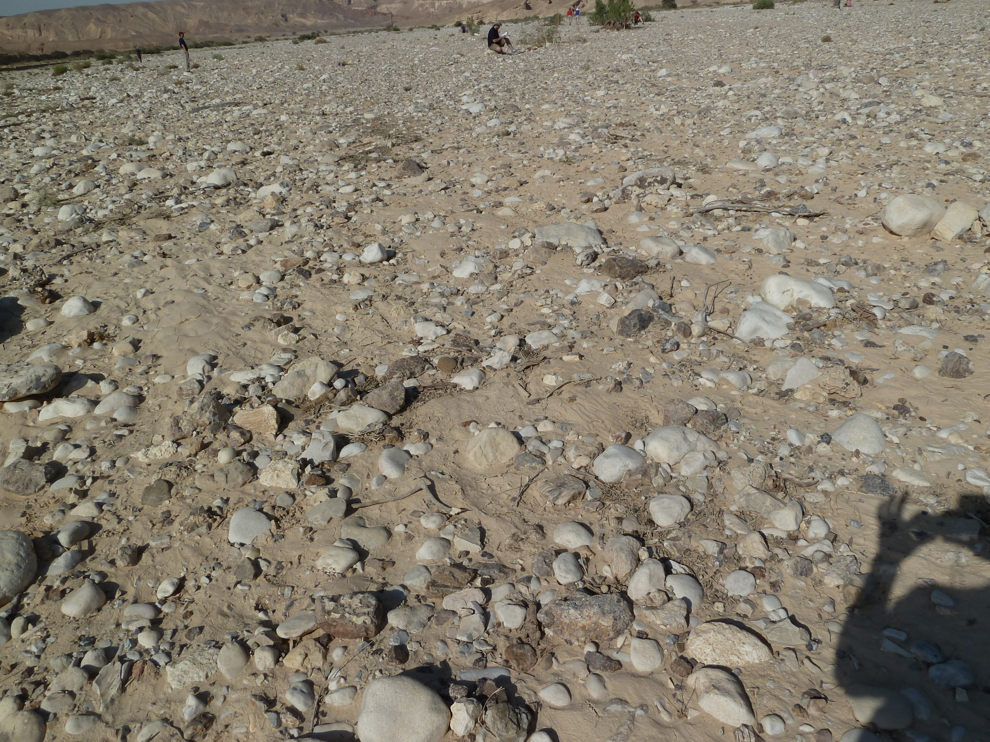
Matthew 13.20-21 NET: The seed sown on rocky ground is the person who hears the word and immediately receives it with joy. But he has no root in himself and does not endure; when trouble or persecution comes because of the word, immediately he falls away.

Slide 14
1. Consider ourselves blessed to have the opportunity to stand for Christ.
Luke 6.22-23 NET: [Jesus speaking] “Blessed are you when people hate you, and when they exclude you and insult you and reject you as evil on account of the Son of Man! Rejoice in that day, and jump for joy, because your reward is great in heaven. For their ancestors did the same things to the prophets.”

Slide 15
2. Love and pray for those who are hurting us.
Matthew 5.44-45 NET: [Jesus speaking] “I say to you, love your enemy and pray for those who persecute you, so that you may be like your Father in heaven, since he causes the sun to rise on the evil and the good, and sends rain on the righteous and the unrighteous.”

Slide 16
3. Continue doing the good work of Jesus among those who persecute us.
Romans 12.14 NET: Bless those who persecute you, bless and do not curse.

Slide 17
4. Stand firm in our faith and convictions.
Galatians 1.10 NET: Am I now trying to gain the approval of people, or of God? Or am I trying to please people? If I were still trying to please people, I would not be a slave of Christ!

Slide 18
5. Rely on God to see us through.
1 Peter 4.11-14 NET: Whoever speaks, let it be with God's words. Whoever serves, do so with the strength that God supplies, so that in everything God will be glorified through Jesus Christ. To him belong the glory and the power forever and ever. Amen. Dear friends, do not be astonished that a trial by fire is occurring among you, as though something strange were happening to you. But rejoice in the degree that you have shared in the sufferings of Christ, so that when his glory is revealed you may also rejoice and be glad. If you are insulted for the name of Christ, you are blessed, because the Spirit of glory, who is the Spirit of God, rests on you.

Slide 19
6. Stay hopeful no matter how bad it gets.
1 Peter 1.3-6 NET: Blessed be the God and Father of our Lord Jesus Christ! By his great mercy he gave us new birth into a living hope through the resurrection of Jesus Christ from the dead, that is, into an inheritance imperishable, undefiled, and unfading. It is reserved in heaven for you, who by God's power are protected through faith for a salvation ready to be revealed in the last time. This brings you great joy, although you may have to suffer for a short time in various trials.

